Slide 1
Using ERT to enter a Semiannual Visible Emission Observation Major and Area Source Foundry NESHAPs
PART OF A HOW-TO SERIES FOR USING ERT AND CEDRI
FOR SEMIANNUAL VE AND COMPLIANCE REPORTING

Slide 2
Verify you have Microsoft Access version 2010 or up
If you do not have Microsoft Access:
You will need to download and install the runtime version of Microsoft Access from the Microsoft Access Download Center. A link to the download center is provided on the EPA ERT website. Please download a version that is the version of office you have installed on your computer.
• MS Access 2010 Runtime.
• MS Access 2013 Runtime.
• MS Access 2016 Runtime.
• After installing the Runtime version of Microsoft Access, follow the instructions below to install and run the ERT.

Slide 3
Downloading and Installing the ERT
The EPA Electronic Reporting Tool (ERT) Webpage contains the latest versions of the ERT, the spreadsheet templates, the user’s guide, and example data sets.
Once you’ve determined that you are running a version of MS Access which is capable of running the ERT Application, follow these two steps.
Download the latest version of the program application. This file includes the latest version of the ERT and the user's guide.
2. To run the ERT, right click on the downloaded zip file and select “Open”. Select a destination for the extracted files. Go to the destination folder and double click on ERTv6.accdb file. It is recommended that the ERT program file and the data set files be located on a local drive (i.e.. C: or desktop). Some functionality of the ERT is lost across servers or external drivers.
To start the ERT, double click ERTv6.accdb file from the location where you’ve installed the ERT application.
Depending on how your version of Access is configured, you may see a “Security Warning” window (as shown below) when you try to start the ERT.

Slide 4
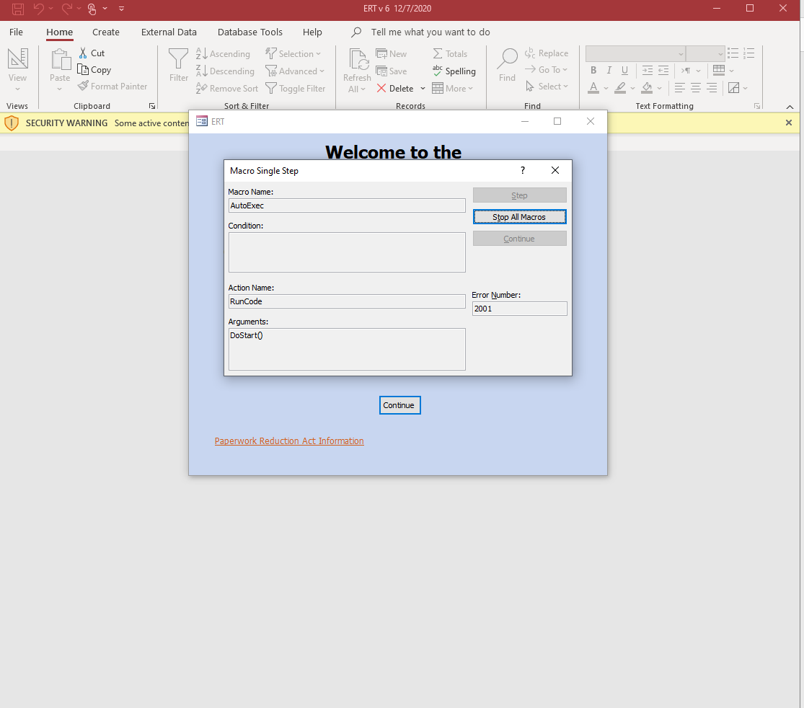
1. Following installation launch the database
2. Select - Stop All Macros and the red X in the upper right-hand corner of the Macro Single Step box

Slide 5
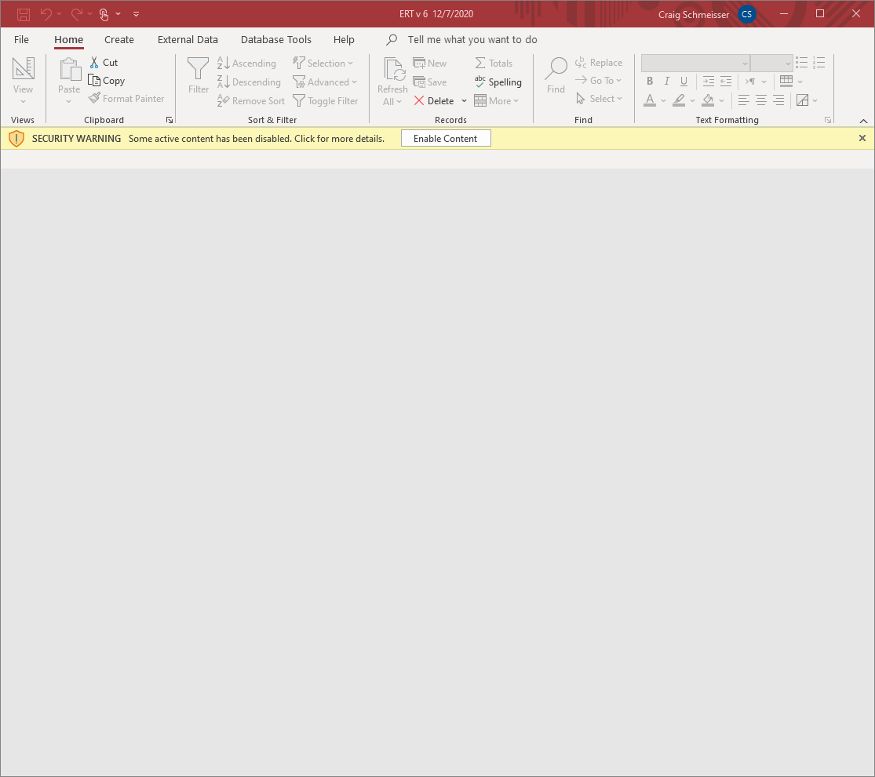
Select - Enable Content
(it is possible you may not see this screen)

Slide 6
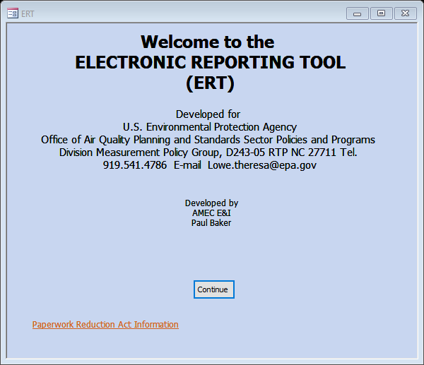
Select - Continue

Slide 7
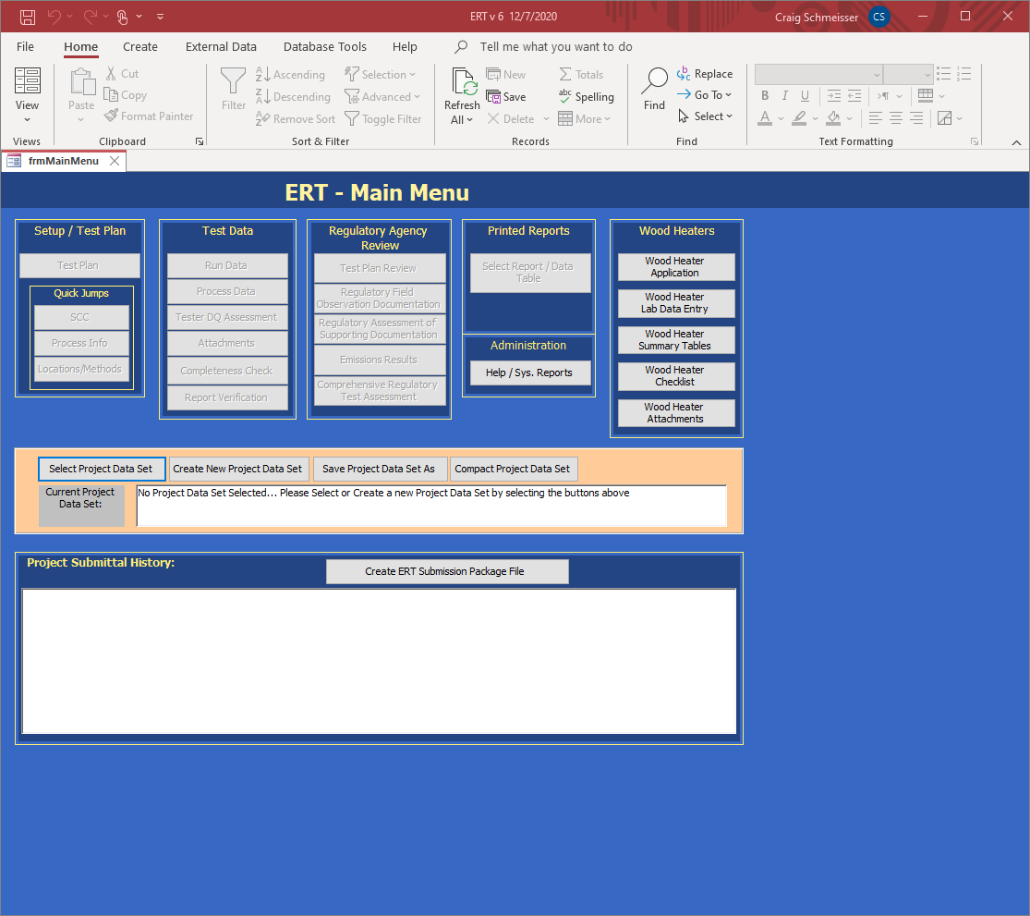
Select -> Create New Project Data Set (PDS)

Slide 8
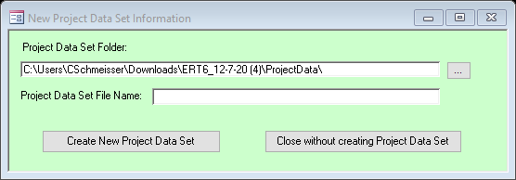
First browse for the location of the folder to store the Project Data Set or maintain the provided and identified default folder.
There have been reported issues with moving the folder so suggest leaving the Project Data Set Folder where it was created.
Enter a Project Data Set File Name
For example -> M22SemiannualJune2021
Select -> Create New Project Data Set
NOTE: The first time you create a project data set you have to do the above steps. Thereafter you can select the above project data set and click on “Save Project Data Set As” to save the entire PDS with another name or save only the test plan part of the first data set as a template.

Slide 9
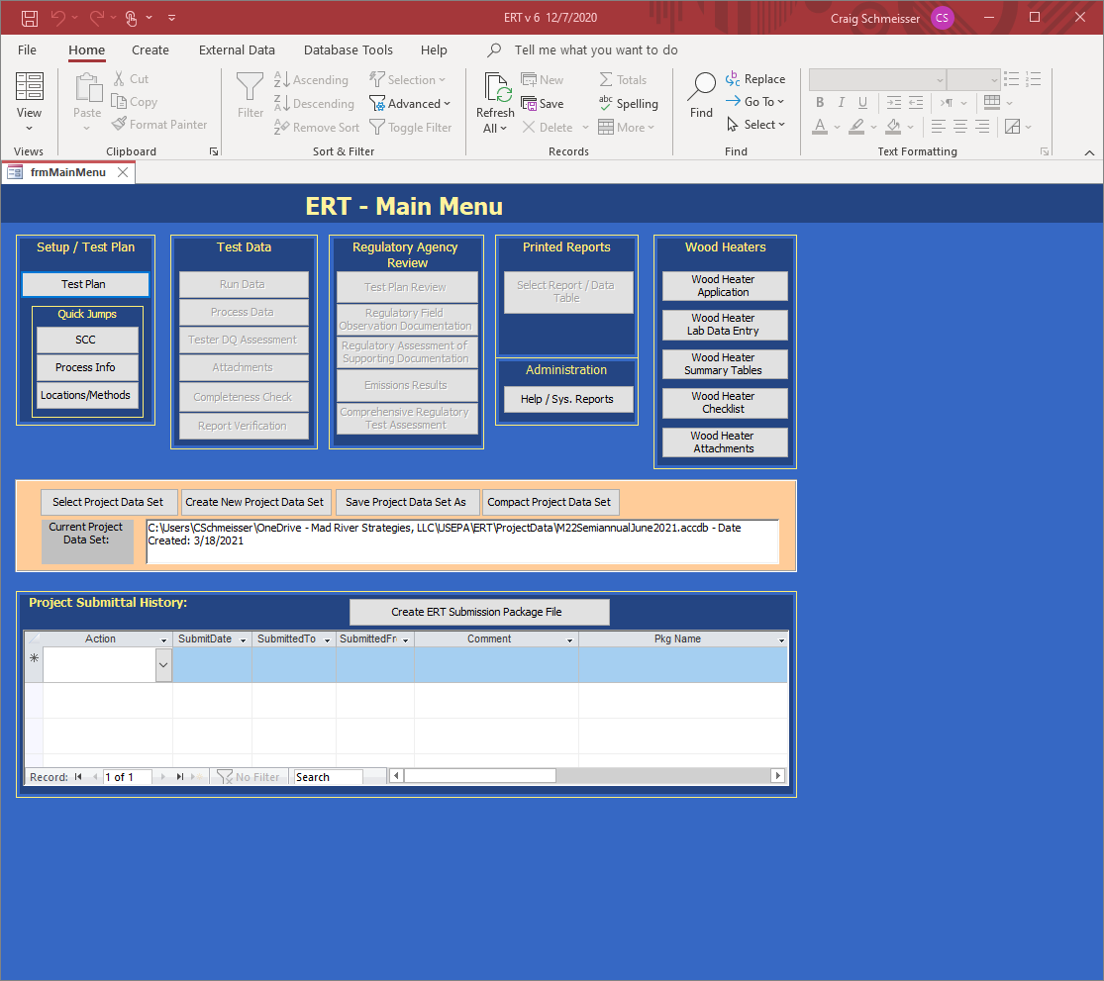
Select -> Select Project Data Set
A browse menu will appear to allow you to select the project data.

Slide 10
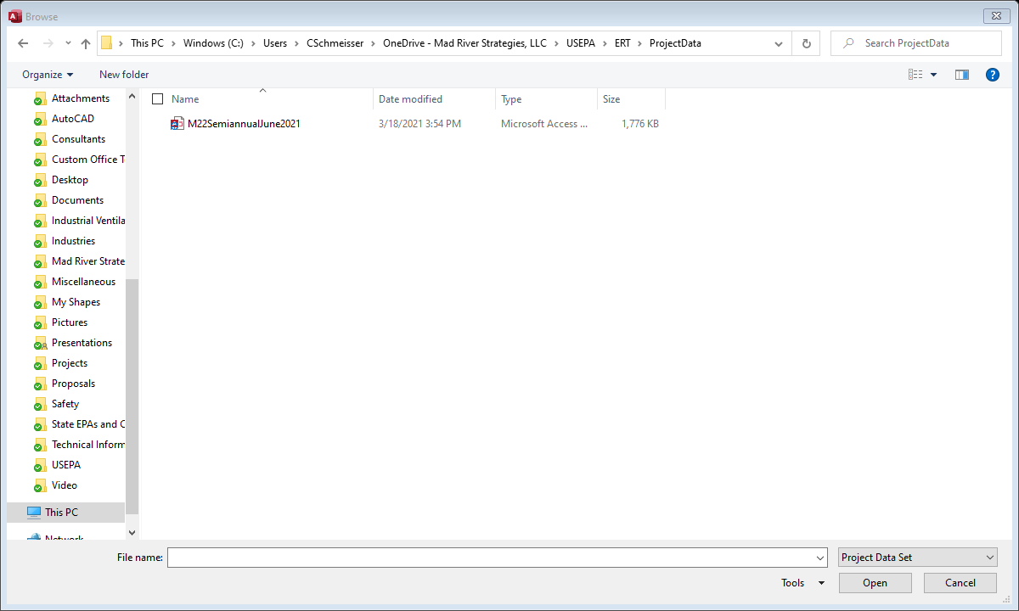
Select the PDS from the default folder and click “Open”

Slide 11
Save Project Data Set As
Source tests for similar sources may contain some of the same information. To keep from having to enter the same information for similar tests, the ERT can save the currently selected PDS as a template. When this happens, a new PDS is created with the current test plan information saved and all the other data deleted. However, the attachments are not deleted and will need to be removed. The new template PDS can then is used as a starting point for a similar source test. The ERT also can save all of current PDS data into a new PDS.

Slide 12
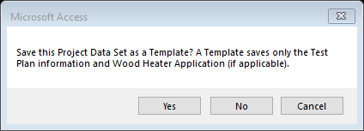
Select -> Yes

Slide 13
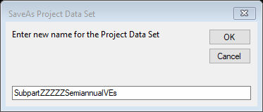
Enter name for your template and select “OK”

Slide 14
If working with a new Project Data Set you will only be able to access the Setup/Test Plan Menu
Select -> Test Plan

Slide 15
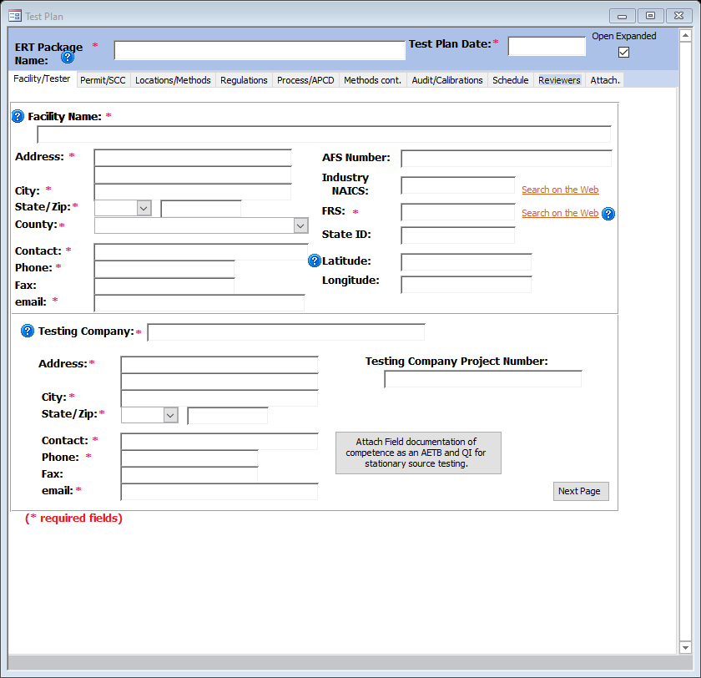
Complete all red asterisk data fields
NOTE AFTER DISCUSSIONS WITH USEPA
I COMPLETED MANY NON-ASTERISK
FIELDS. ON THE FOLLOWING SLIDES
YOU MAY CHOOSE TO DECREASE SOME
DATA ENTRY, AS LONG AS MEANINGFUL
INFORMATION IS RETAINED.
Complete all red asterisk data fields
After completing move to the next
section by clicking “Next Page”

Slide 16
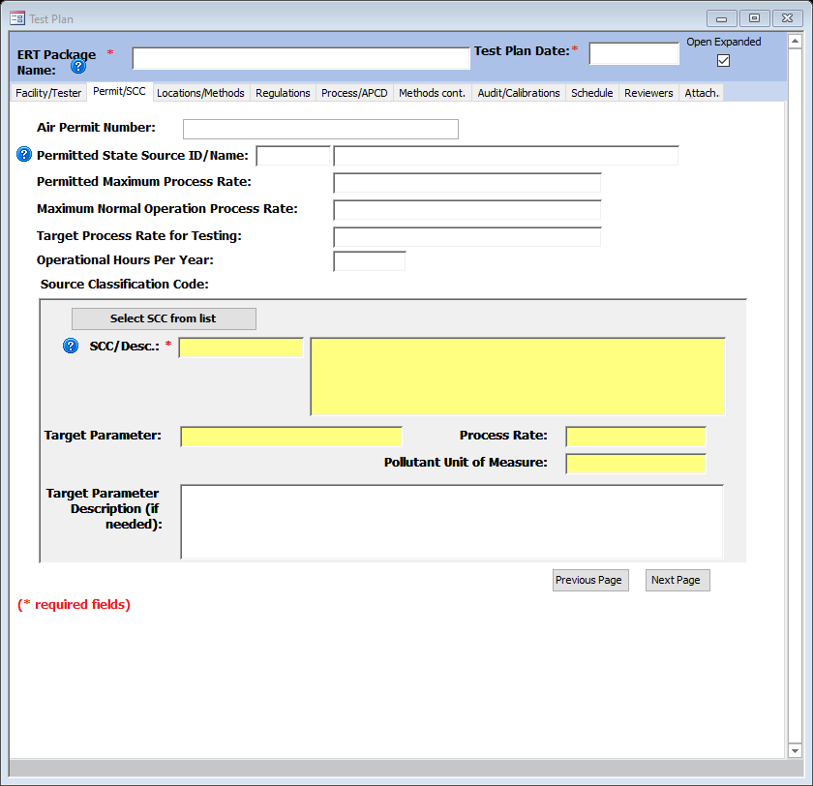
Select -> Select SCC from list

Slide 17
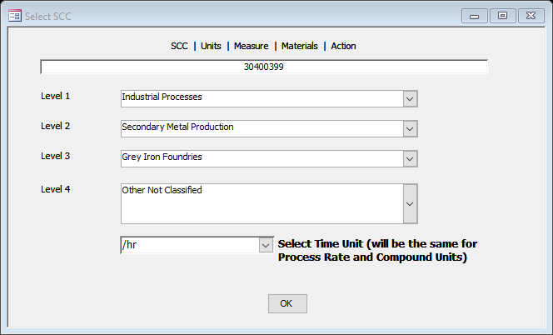
Select these levels which will then populate “30400399”
Select “/hr” from the Select Time Unit drop down menu then select “OK”

Slide 18
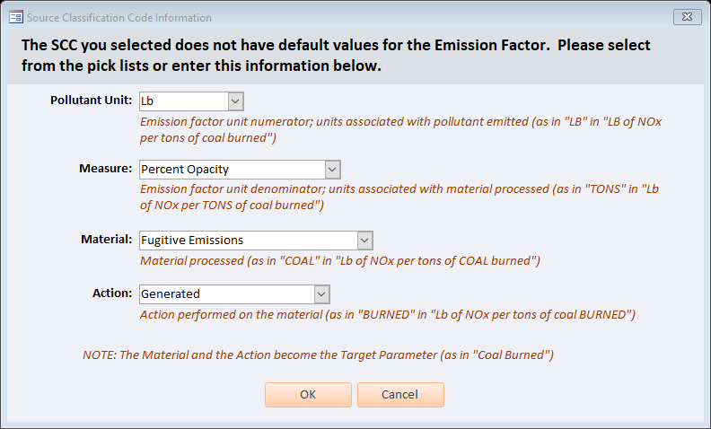
After selecting “OK” from the previous screen this popup appears.
Following discussions with USEPA these were the suggested selections or entries.
After completing select “OK”

Slide 19
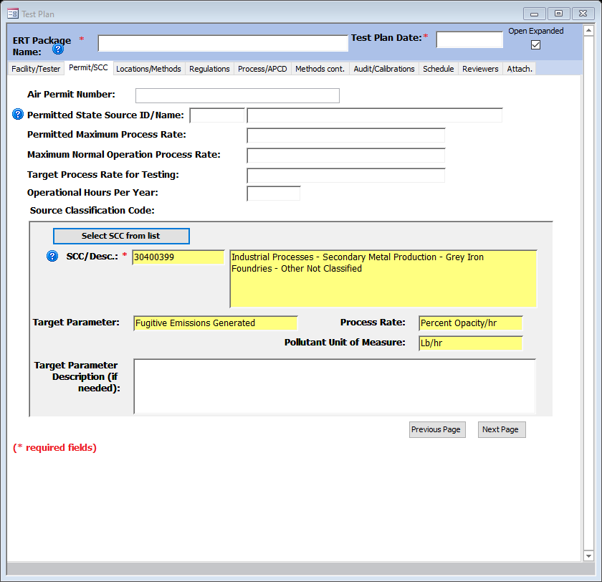
Select -> Next Page

Slide 20
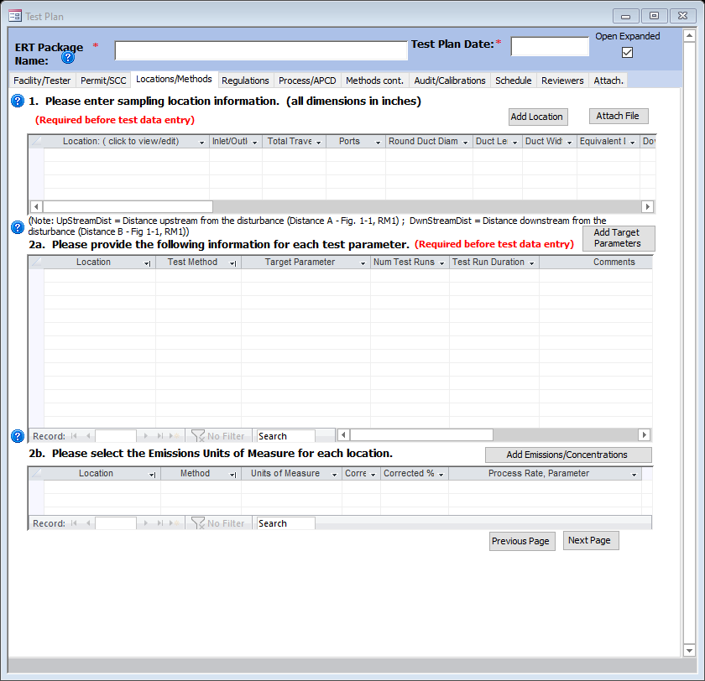
Select -> Add Location

Slide 21
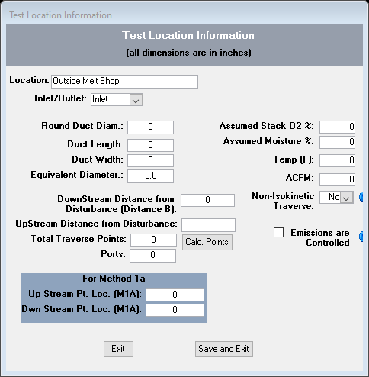
Enter a name for the VE Location
Select -> Save and Exit

Slide 22
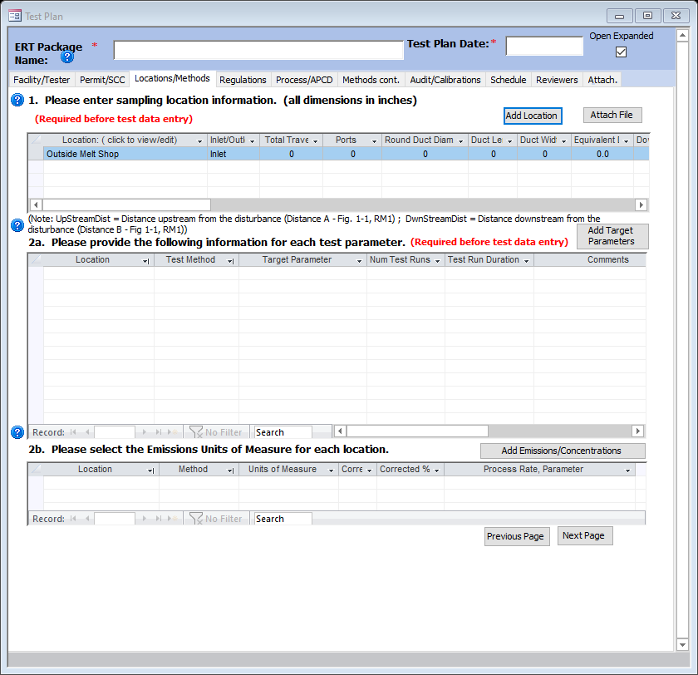
Select -> “Add Target Parameters”

Slide 23
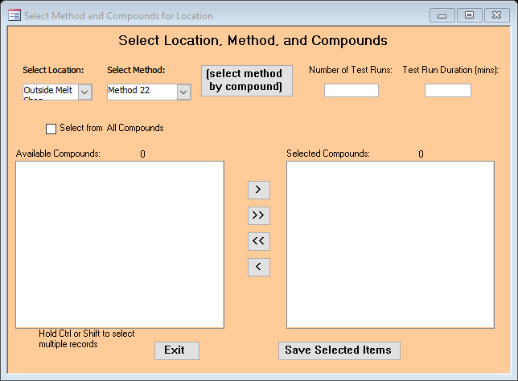
From Select Location Drop Down Menu ->
Select the Location you Entered
From the Select Method Drop Down Menu ->
Select “Custom”
Note: Method 22 will not appear until later.

Slide 24
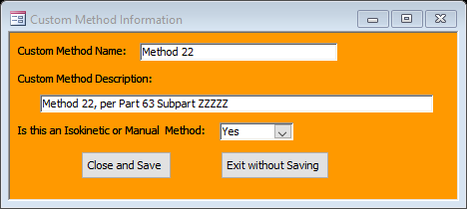
After selecting “Custom” this popup menu appears. Complete and select -> Close and Save
USEPA has indicated they plan on including Method 9 and possibly Method 22 in future releases of ERT.

Slide 25
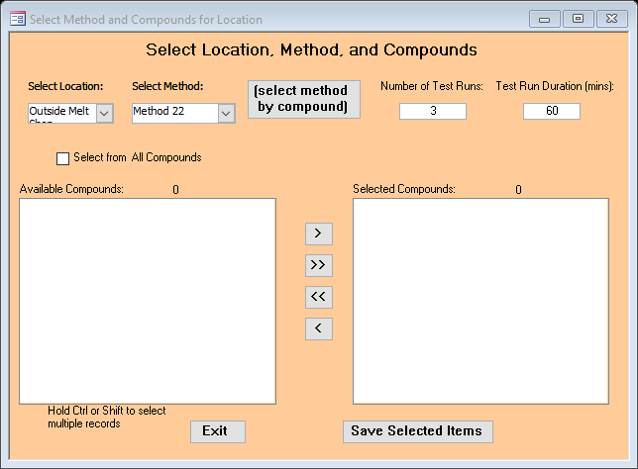
Enter “Number of Test Runs” and “Test Run Duration”

Slide 26
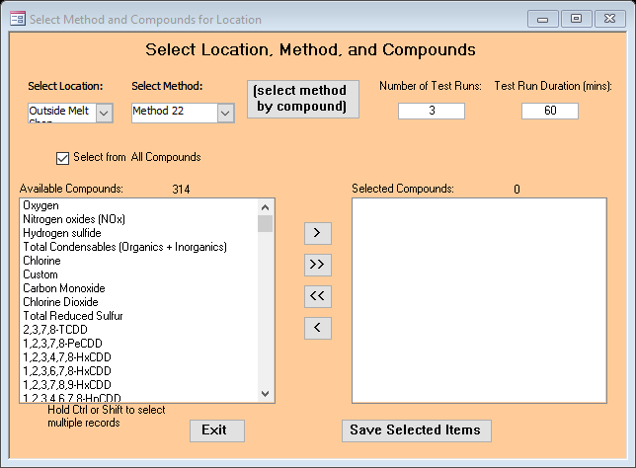
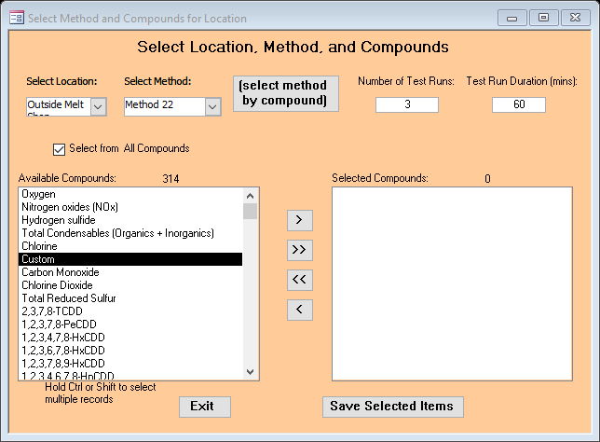
Check the “Select from All Compounds” box
Select this Leader
Select “Custom” from the Drop Down Menu

Slide 27
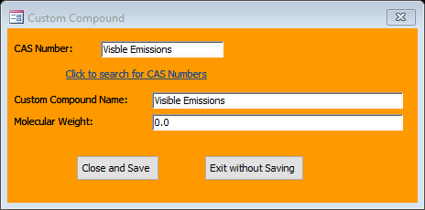
After selecting the leader in the previous slide this popup box opens.
Complete the required entries and Select -> Close and Save

Slide 28
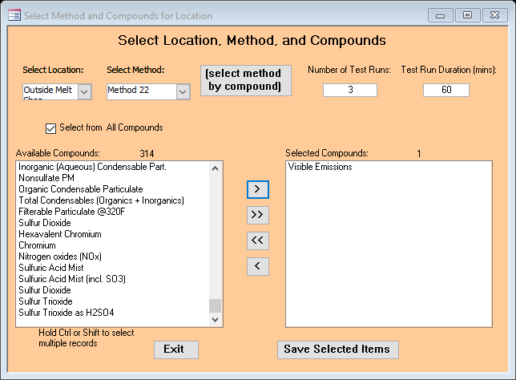
Select -> “Save Selected Items”

Slide 29
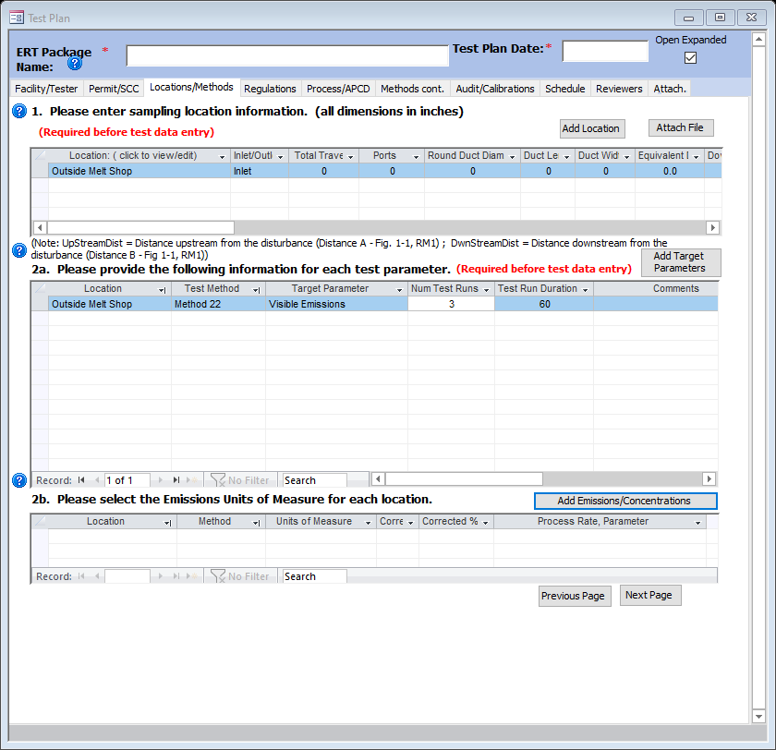
Select -> Add Emissions/Concentrations

Slide 30
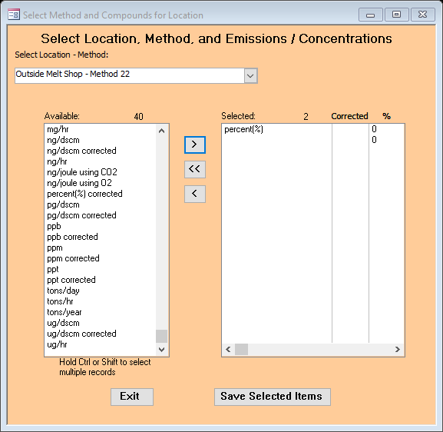
This Popup will appear.
Select Location from the Drop Down Menu
Whether using a M-9 or M-22 select > percent(%) from the Available menu and move it over by selecting the leader.
Select -> Save Selected Items

Slide 31
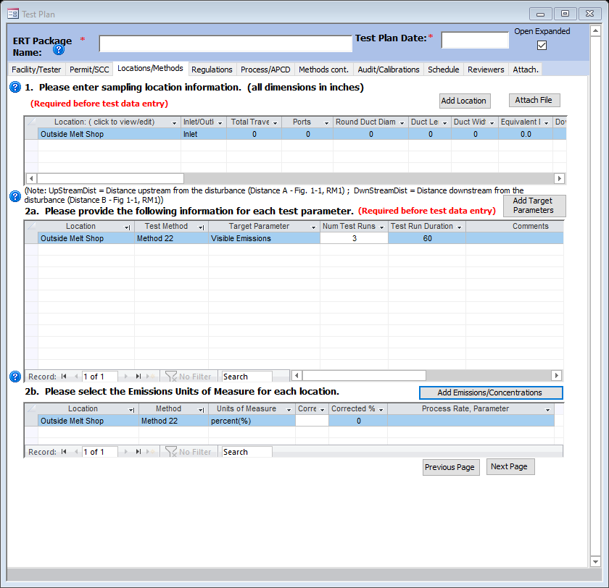
Select Next Page

Slide 32
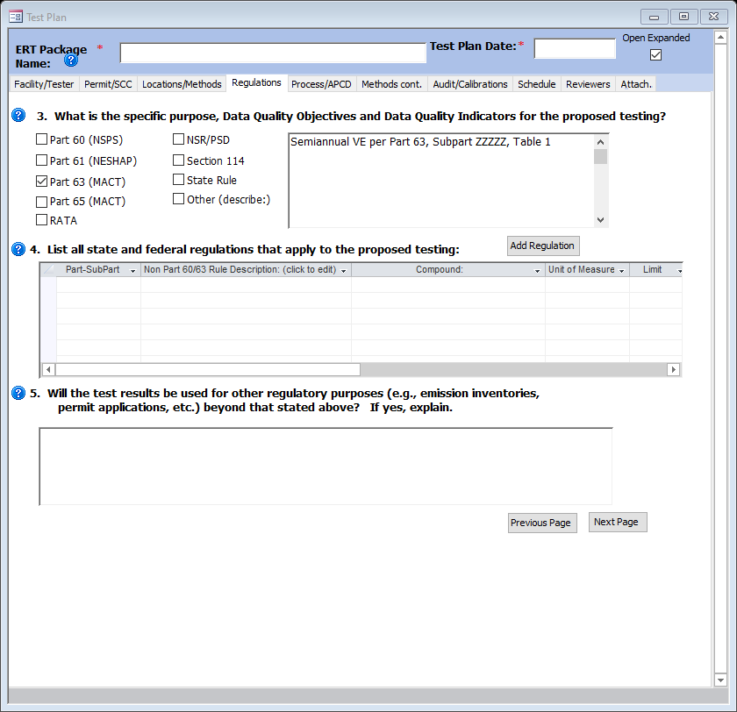
Enter a description of the test
Check the “Part 63 (MACT)” box
Select -> Add Regulation

Slide 33
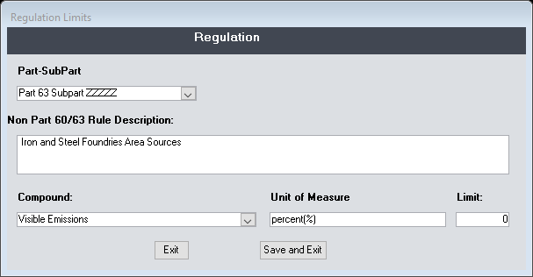
Select Part 63 Subpart EEEEE if a Major Source
or
Select Part 63 Subpart ZZZZZ if an Area Source of HAPs
Select “Visible Emissions” from the Drop Down Menu
Select “Save and Exit”

Slide 34
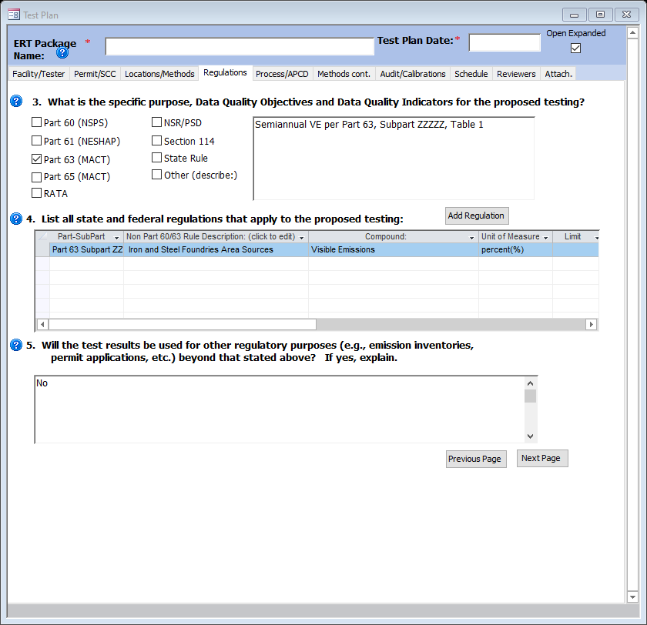
If test will not be used for other than NESHAP compliance enter “No”; otherwise enter “Yes” and explain
Select -> Next Page

Slide 35
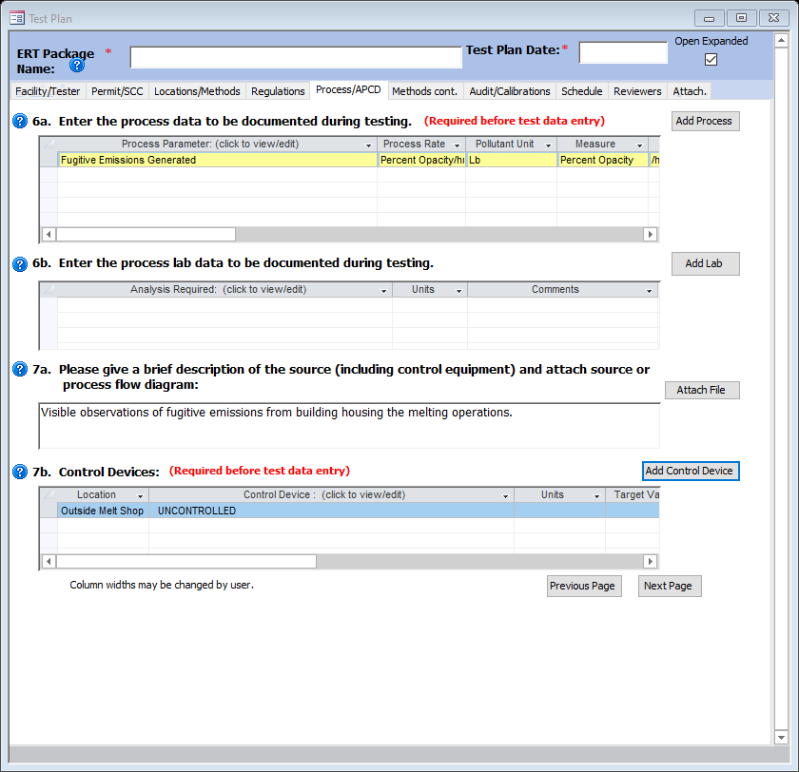
Select -> Add Process
Select -> Add Control Device

Slide 36
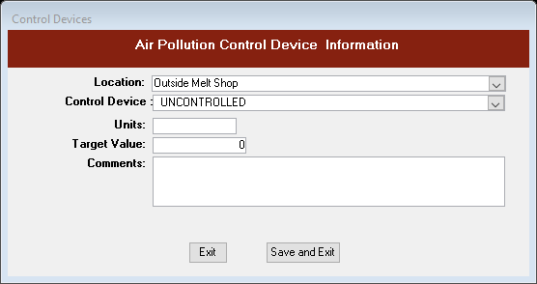
Select Location from Drop Down Menu
Select “UNCONTROLLED” from the Drop Down Menu
Select -> Save and Exit

Slide 37
Select -> Next Page

Slide 38
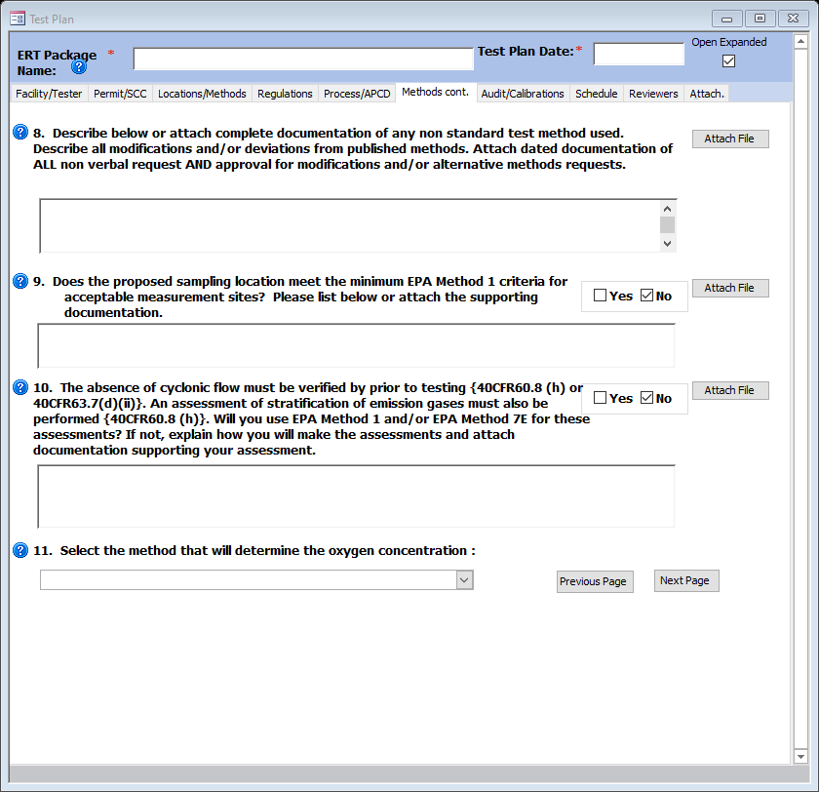
Select -> Next Page
The “next page” the audit calibration is not shown in this slide deck. Just select “Next Page”

Slide 39
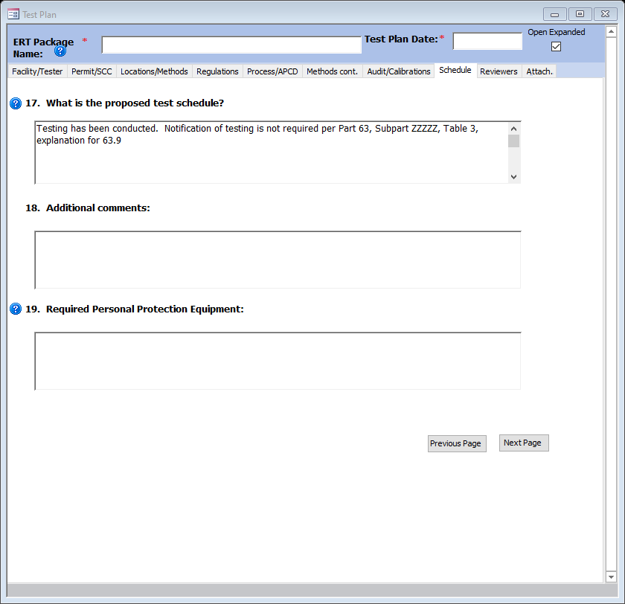
This language is Area Source specific language. It is possible that major sources need to provide a 30-day notification prior to a VE
test.
Select -> Next Page

Slide 40
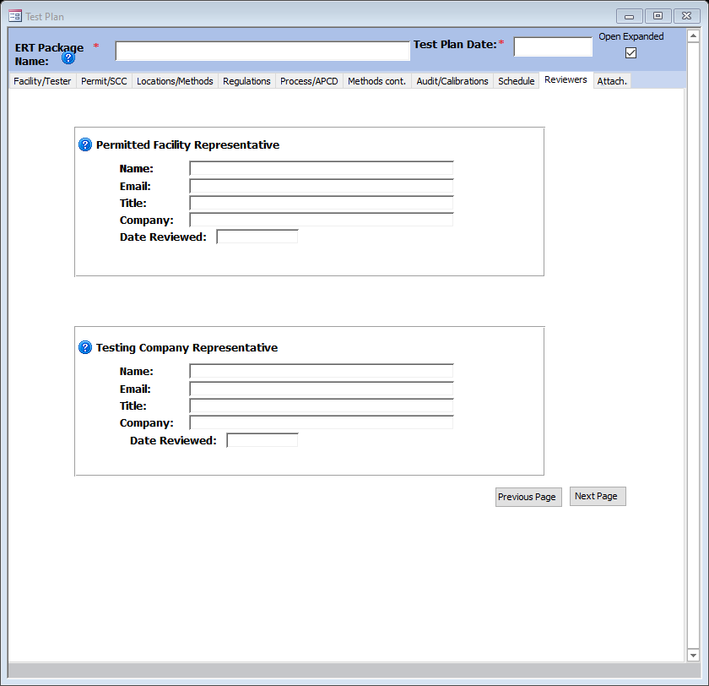

Slide 41
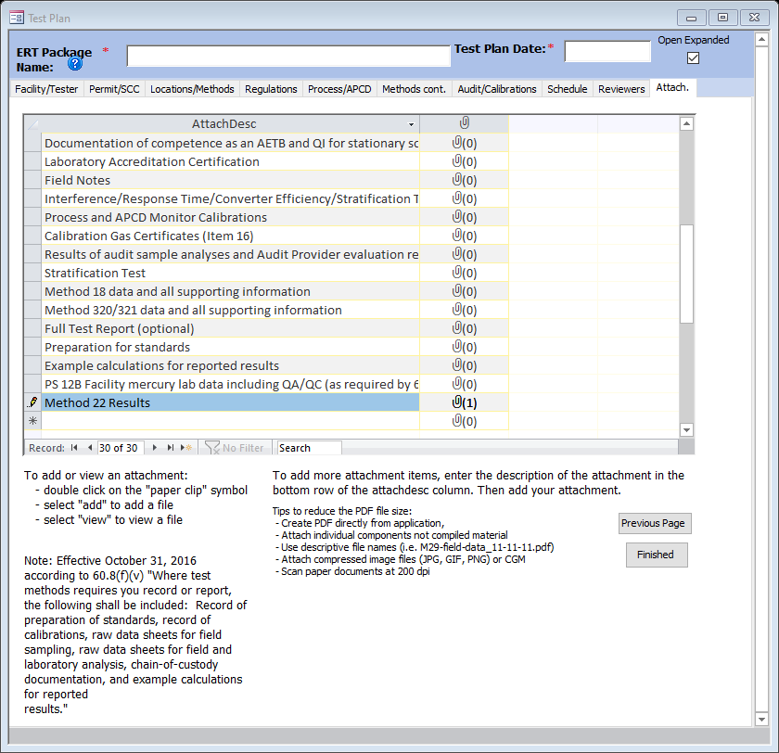
Select the paperclip and select and attach test results.
Select -> Finished

Slide 42
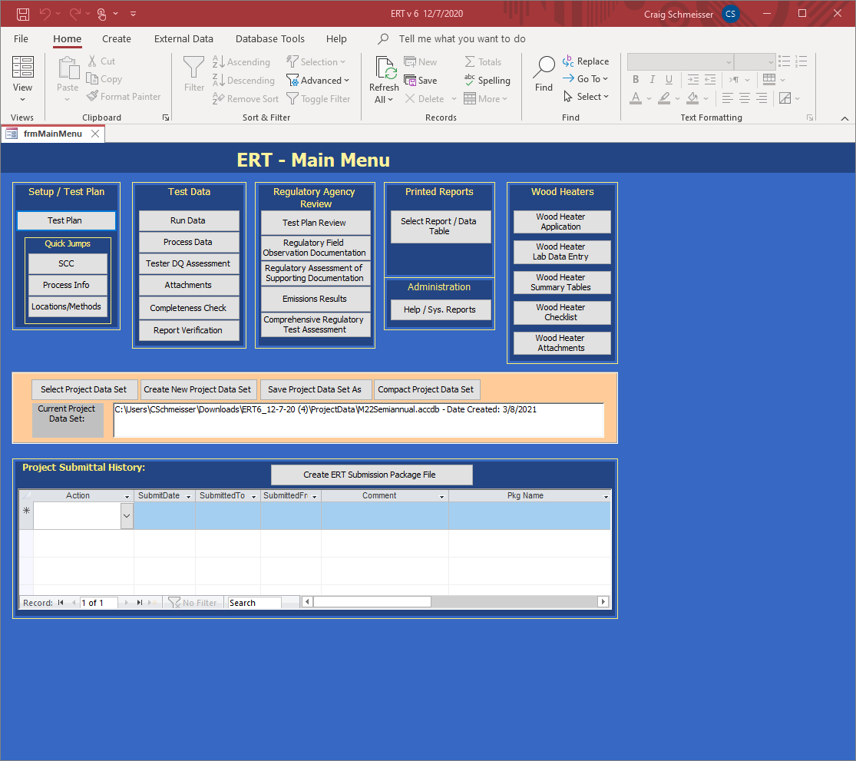
To create a submission file, click “Create ERT Submission Package File.” If any required fields are not complete, a window will open with a list of links to the screens. Click on the links to the screens to complete the fields. Once the field window is closed, click on the “Re-Check Data” button. When all the required fields have been completed, the “Create ERT Submission File” window will open as shown on next slide.

Slide 43
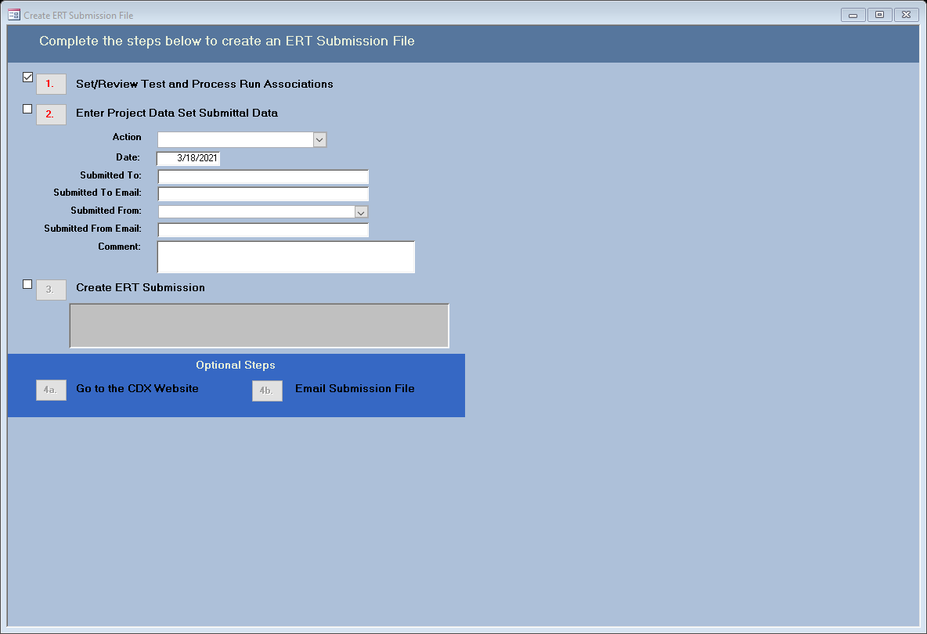
Select ->>> “1” and the next screen will appear

Slide 44
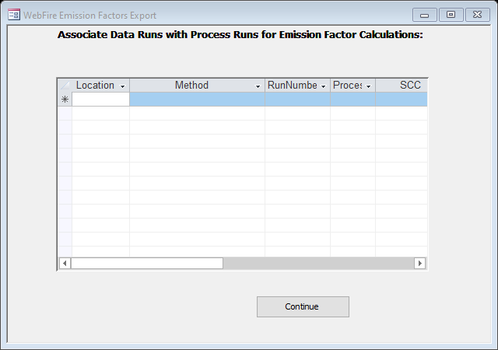
Click on “Continue” button to skip this process and continue to create the submission package file.

Slide 45
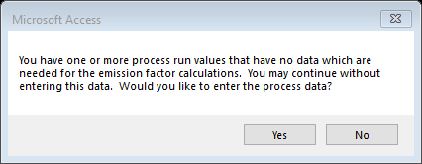

Slide 47
Select 2 and complete if you only if you would like.
Select 3
An action window will appear with instructions as it creates the ERT Submission file, a PDS zip file and an ERT Submission zip file. When the “Finished” is clicked, the location of the field will be reported in the field.

Slide 48
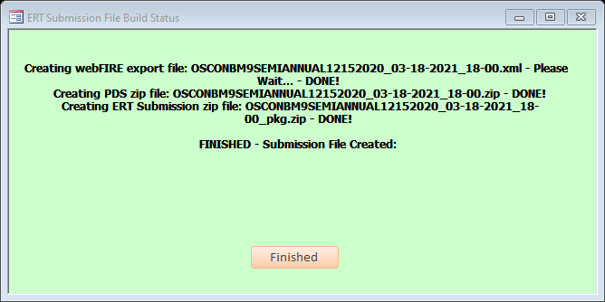

Slide 49
