Slide 1
Using CEDRI to Create and Upload a Semiannual Compliance Report Major and Area Source Foundry NESHAPs
PART OF A HOW-TO SERIES FOR USING ERT AND CEDRI
FOR SEMIANNUAL VISIBLE EMISSIONS AND COMPLIANCE REPORTING

Slide 2
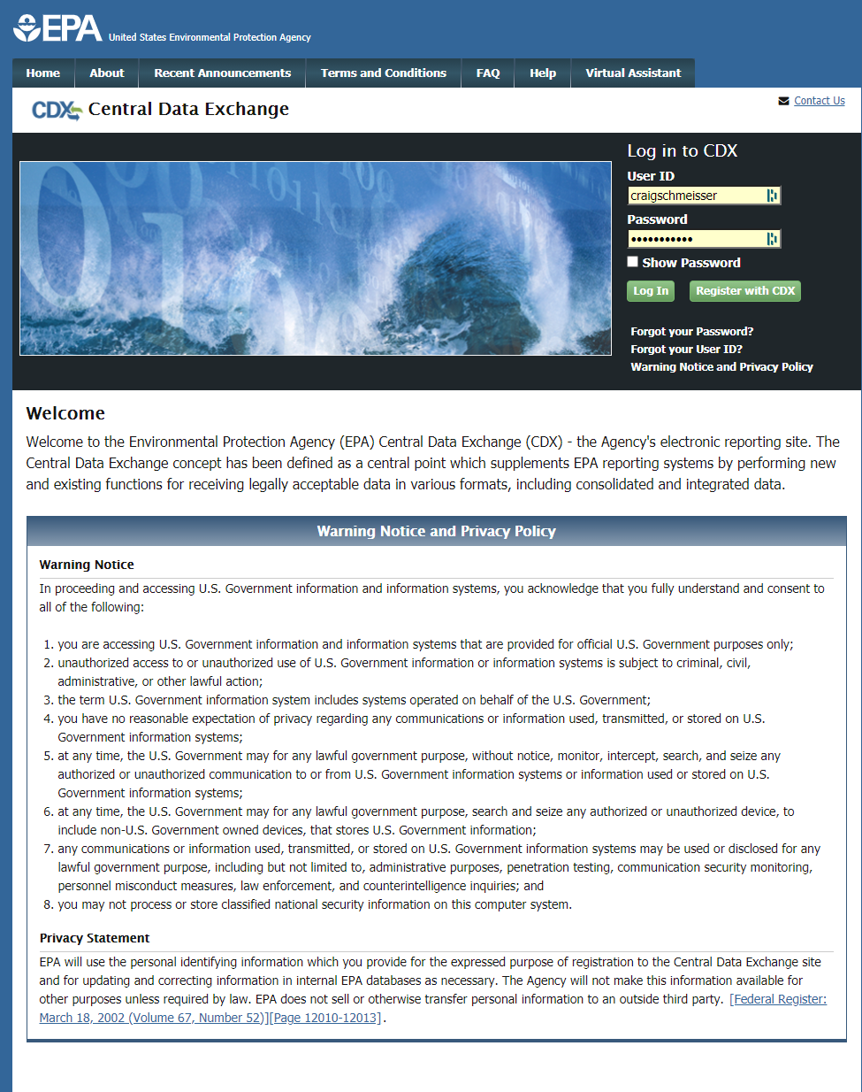
Login to CDX

Slide 3
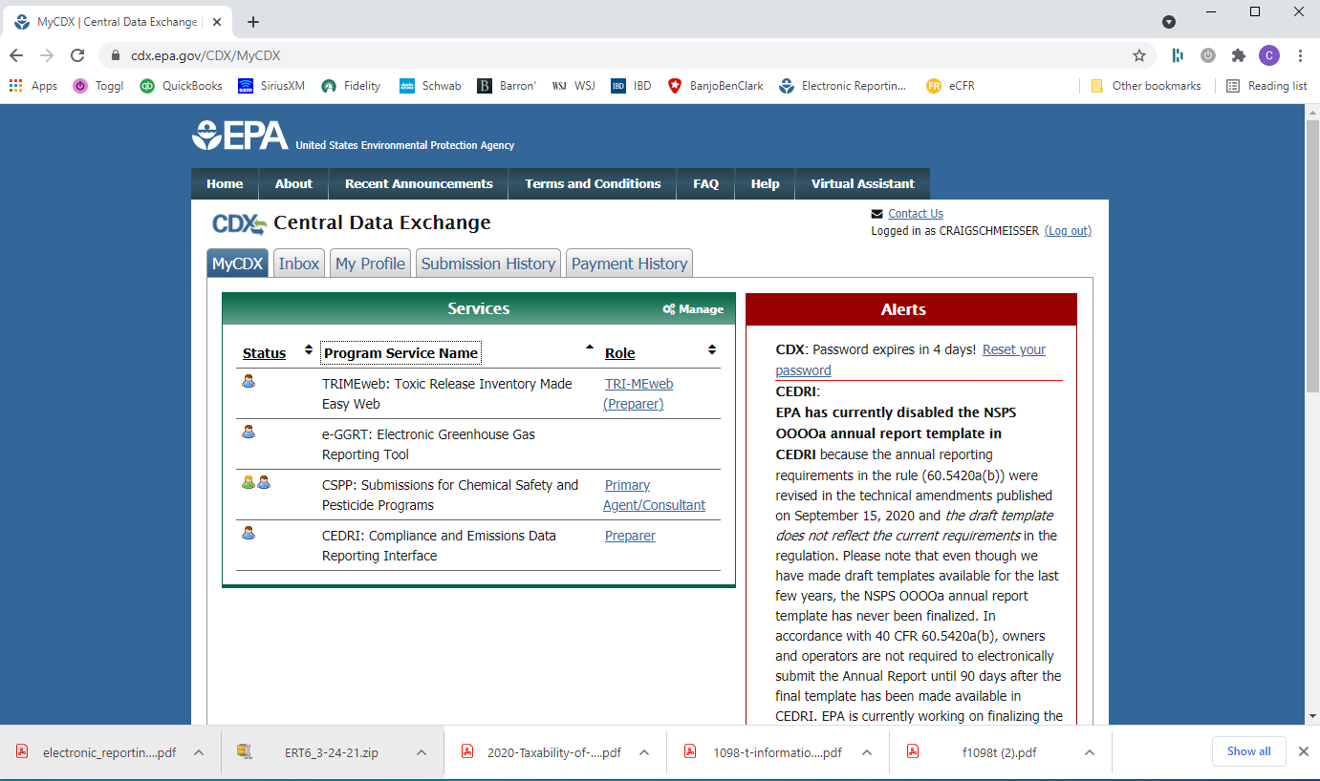
Select->”Preparer”

Slide 4
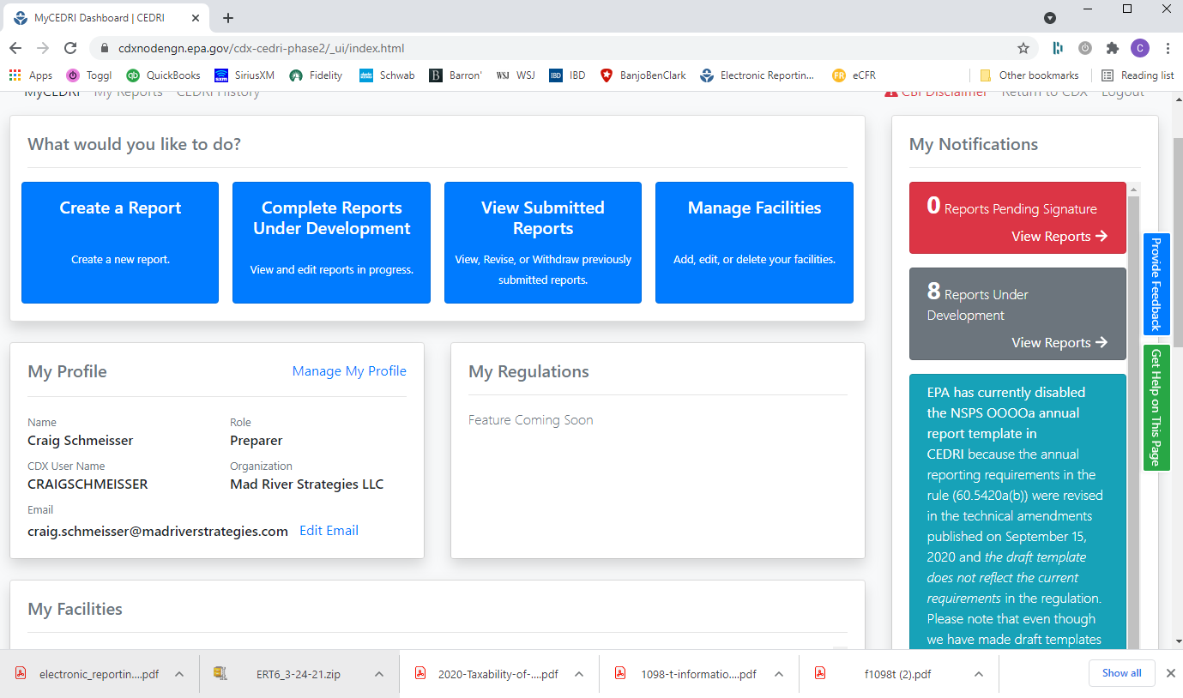
Select” Create a Report”

Slide 5
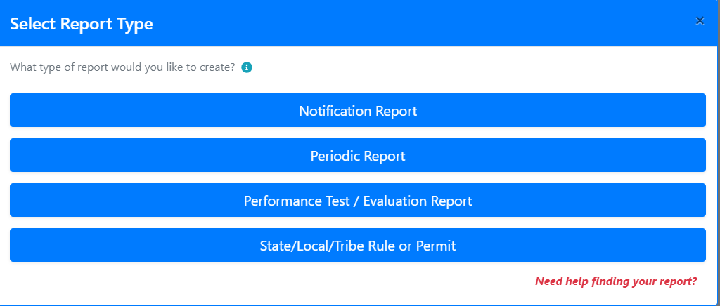
Select->”Periodic Report”

Slide 6
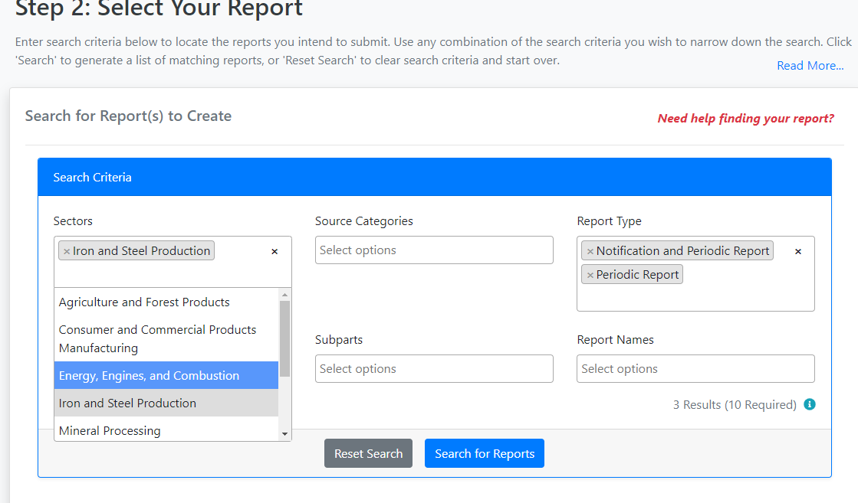
Under Sectors scroll down and
Select->”Iron and Steel Production”

Slide 7
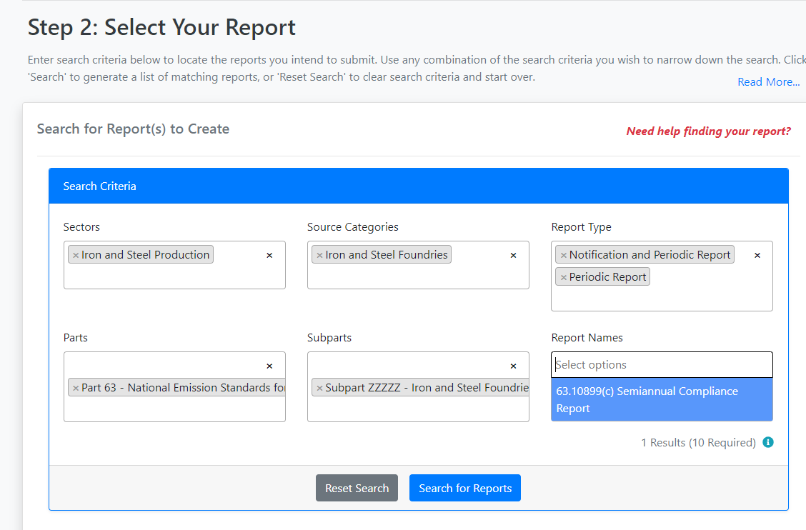
Under Source Categories, Parts, Subparts and
Report Names Select the Appropriate Responses
Select->”Search for Reports”

Slide 8
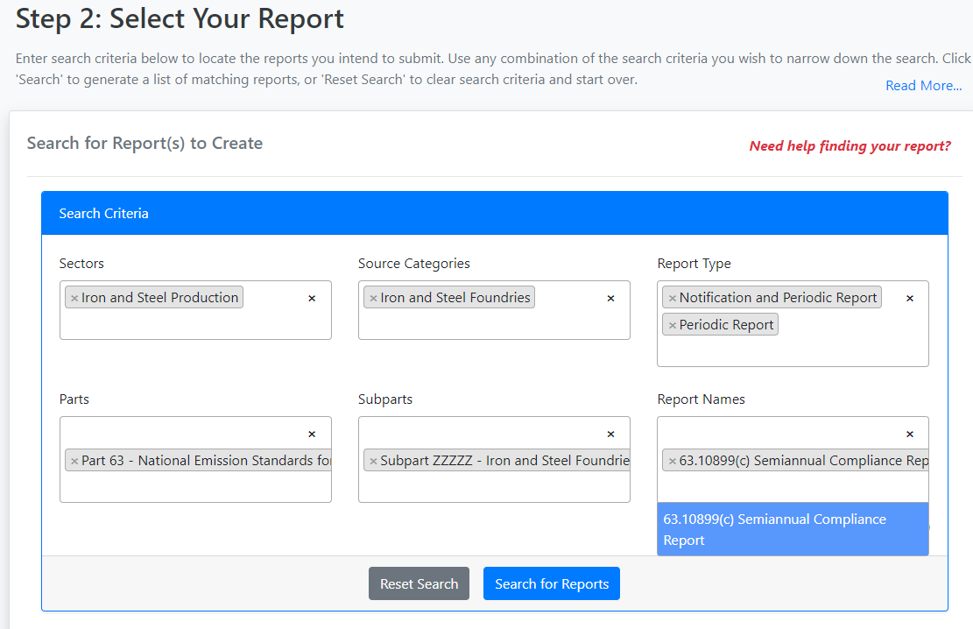
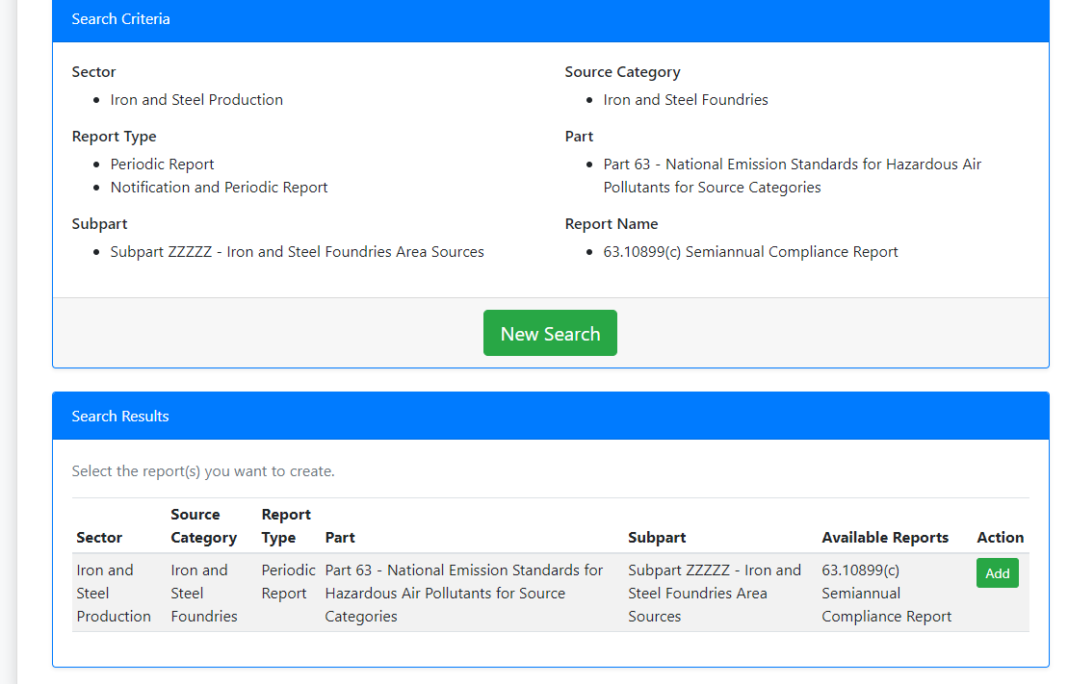
Select->”Add”

Slide 9
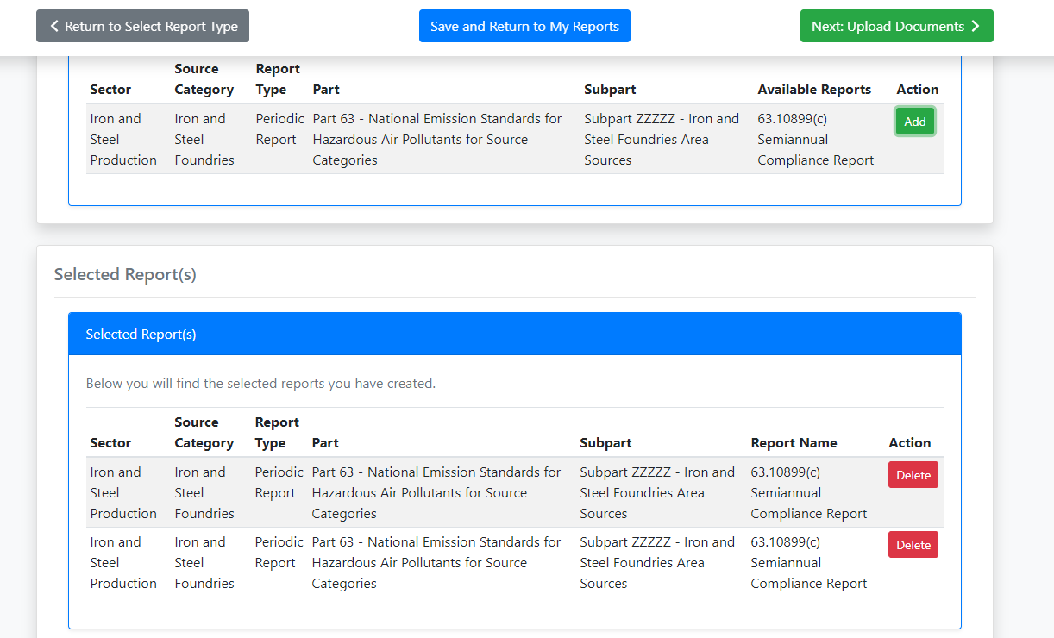
Select->”Next:Upload Documents”

Slide 10
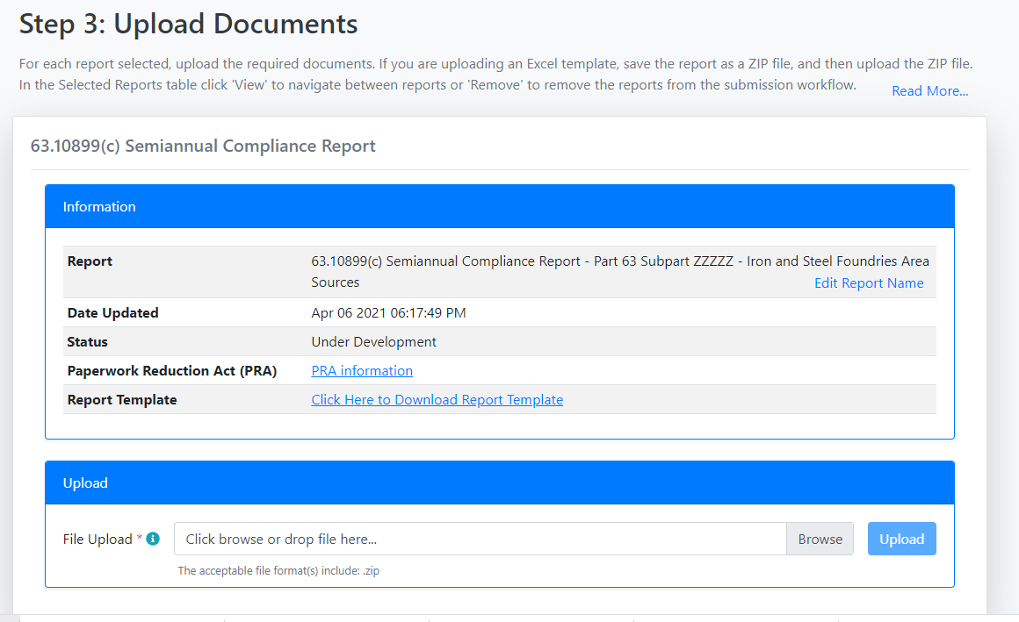
Select->”Click Here to Download Report
Template”
An Excel Worksheet will now download

Slide 11
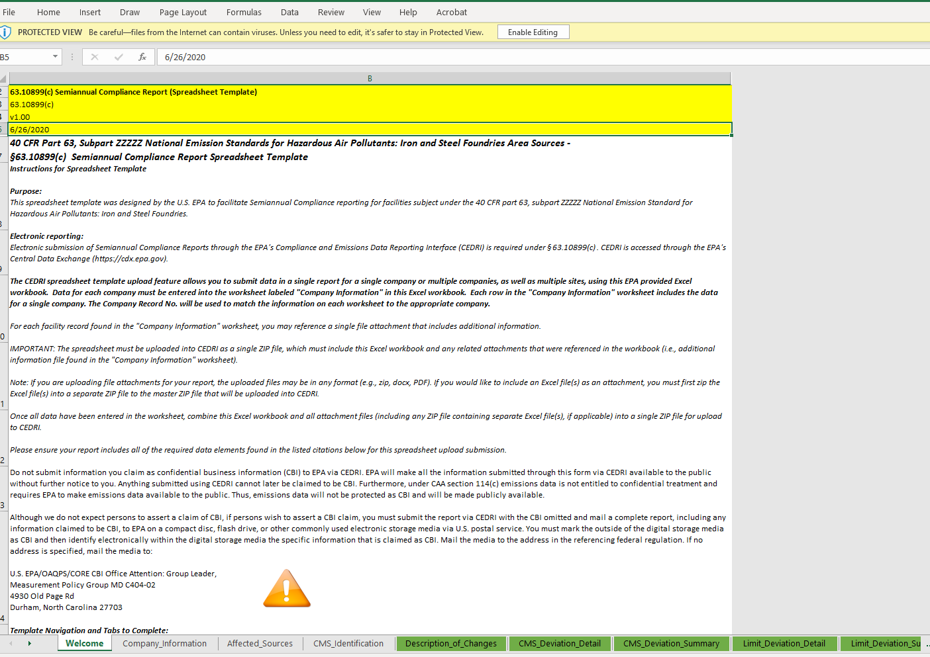
Select->”Enable Editing”
Note below. Once you complete
all workbook tabs you need to “zip” the
workbook prior to attempting to upload
via CEDRI. Note you should complete
each tab below.
There are tabs/worksheets to the
right of the last circled below that
should be completed.

Slide 12
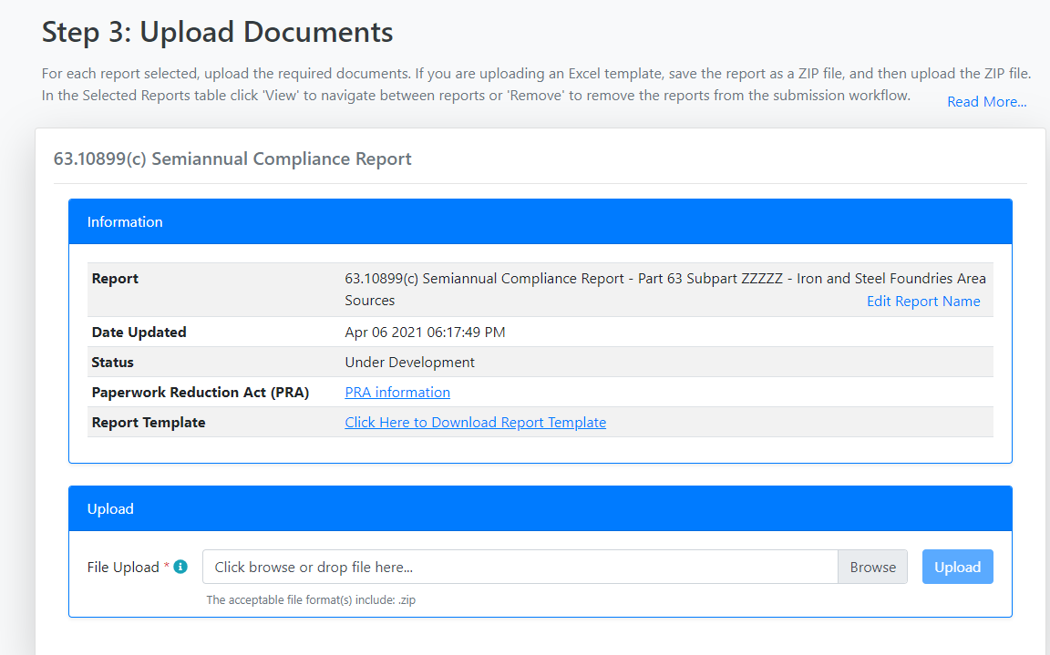
After you complete and zip the compliance
report the zip file must be uploaded.
Select->”Browse” and navigate to
the zip file

Slide 13
Select->”Upload” to upload
the zip file

Slide 14
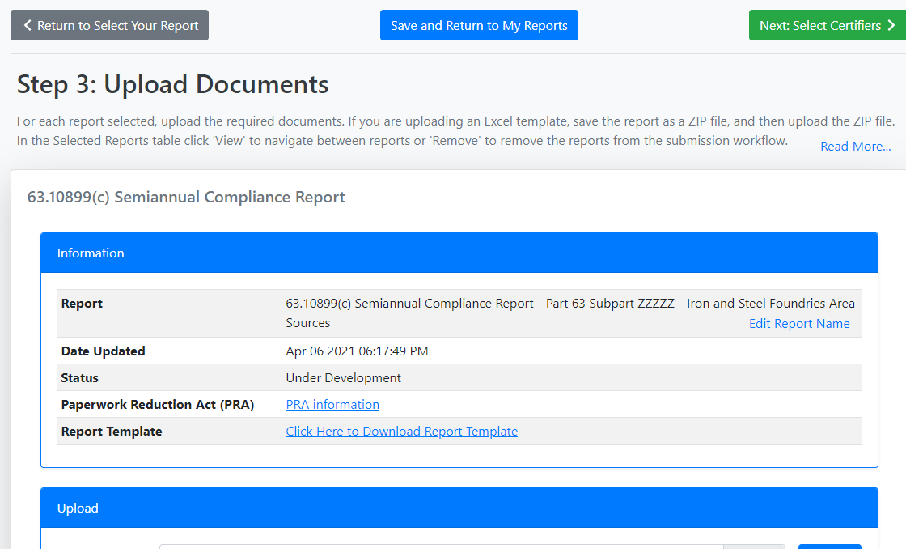
Select->”Next: Select Certifiers”. This will allow you to select and send the report to the certifying official.

